Slide 1
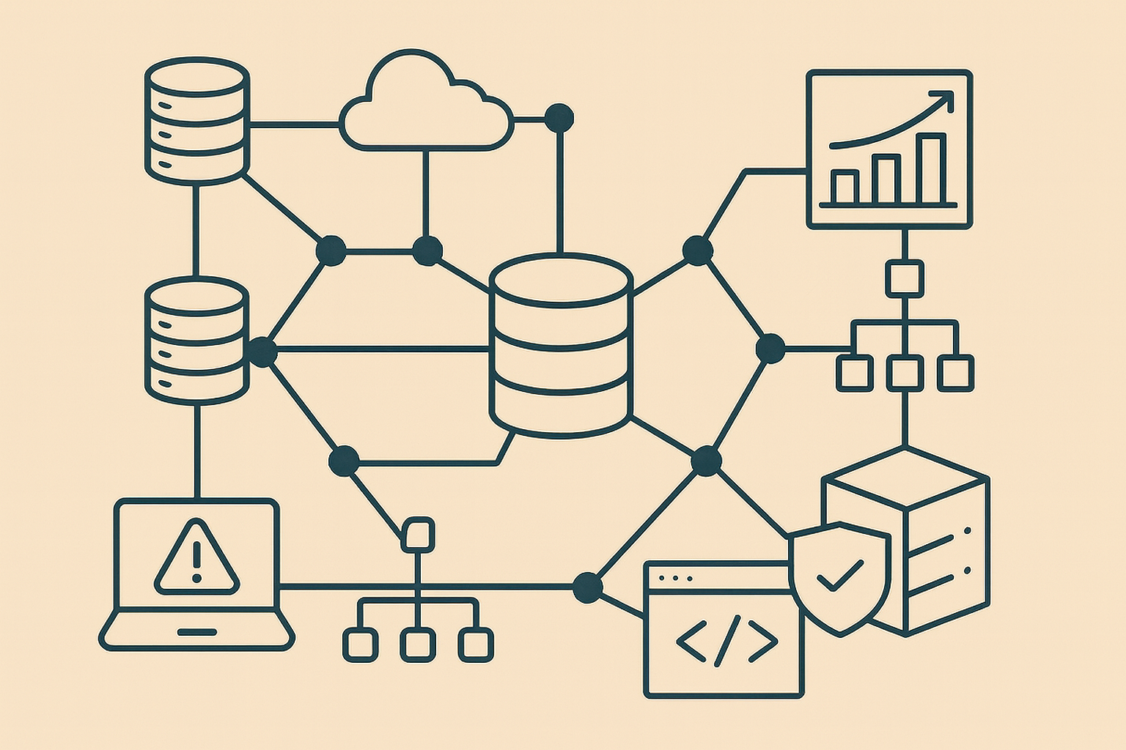
INTRODUCTION TO DATABASES
Dr. Ronnie de Souza Santos, PhD

Slide 2
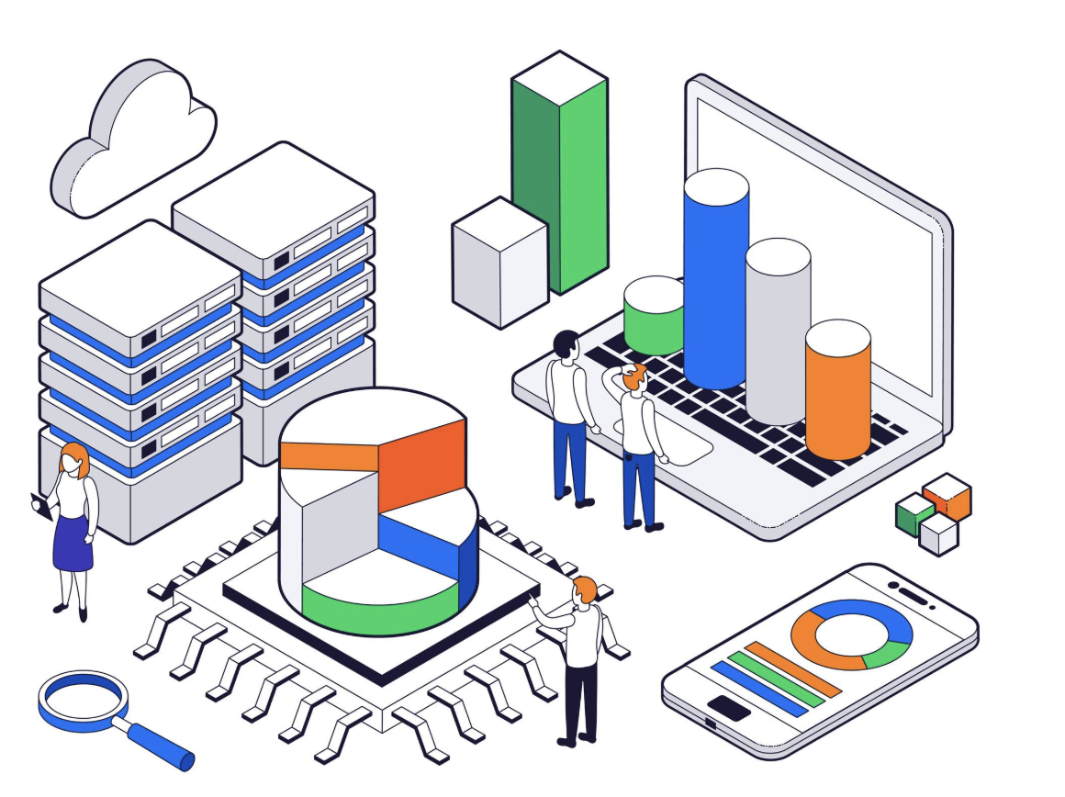
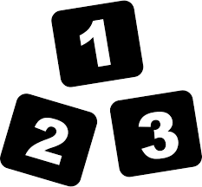



DATA
Data is a raw form of knowledge coming from many sources and do not have to carry any significance or purpose on its own but can be processed and analyzed to produce meaningful information.
STRUCTURED DATA
UNSTRUCTURED DATA
SEMI-STRUCTURED DATA

Slide 3
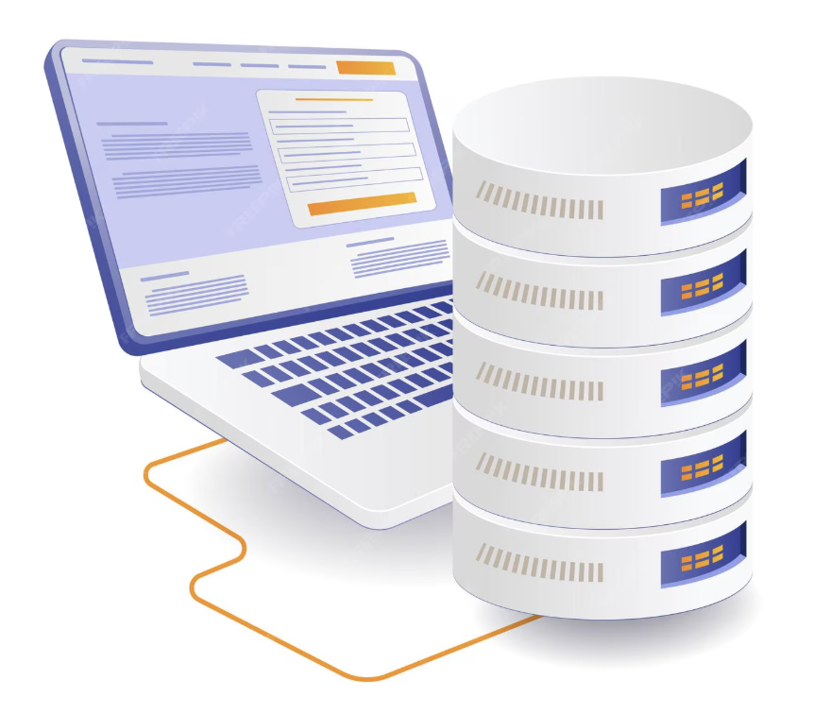

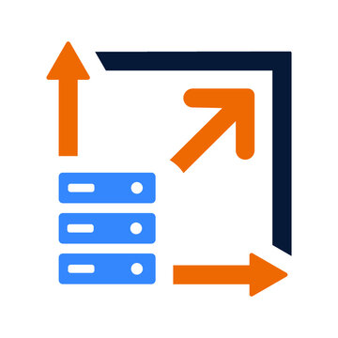

WHY DATA STORAGE IS IMPORTANT?
Different types of data require different methods of storage, management, and analysis. The type of data influences the choice of storage solutions, management techniques, and analytical methods.
COMPLEXITY
SCALABILITY
FLEXIBILITY

Slide 4




WHAT IS A DATABASE?
Computer databases are used for storing, maintaining, and accessing any sort of data. In modern industries, databases are critical for managing and processing large amounts of data.
STORE
QUERYING
HANDLING

Slide 5
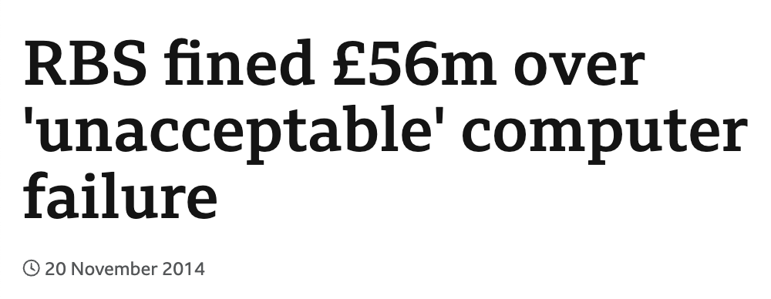


WHAT CAN GO WRONG WITH DATABASE?
DO YOU KNOW OF ANY CASE OF A DATABASE THAT WENT WRONG?
A botched software update to the batch processing system at RBS caused a major outage, preventing customers from accessing their accounts. The problem originated from a database-related issue, where the update process failed and corrupted the transaction logs, leading to a cascade of errors that affected account balances and transaction processing.
Knight Capital Group, a large American financial services firm, experienced a major technical glitch, which included a database configuration error. This error caused the trading system to send out incorrect stock orders.

Slide 6




WHAT CAN GO WRONG WITH DATABASE?
VALIDATION
PERFORMANCE
SECURITY
RECOVERY

Slide 7
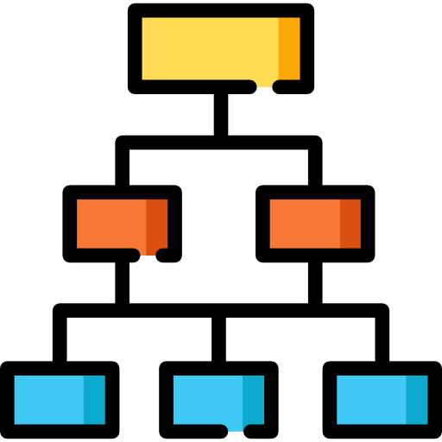
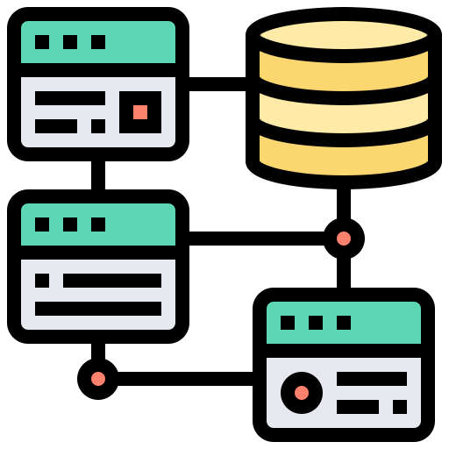

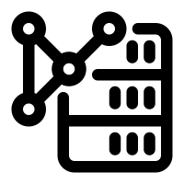
TYPES OF DATABASE
HIERARCHICAL
RELATIONAL
NOSQL

Slide 8
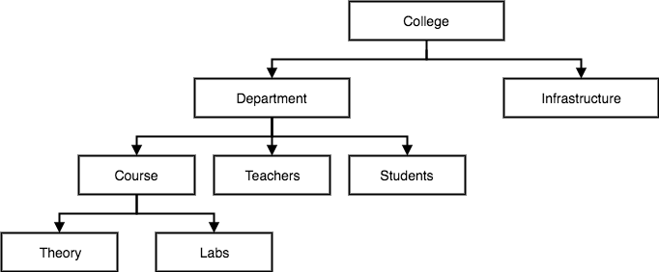
HIERARCHICAL DATABASE
Organize data in a tree-like structure with a single root and multiple levels of data.
Each parent can have multiple children, but each child has only one parent.
Uses: Applications with hierarchical relationships, such as organizational charts or file systems.

Slide 9
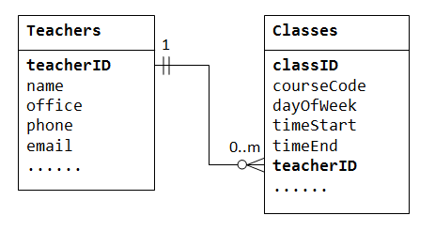
RELATIONAL DATABASE
Relational databases store data in tables (or relations), where each table consists of rows and columns.
Relationships between tables are established through keys (primary and foreign).
Uses: Applications requiring complex queries and transactional consistency, such as banking systems, inventory management, and academic records.

Slide 10
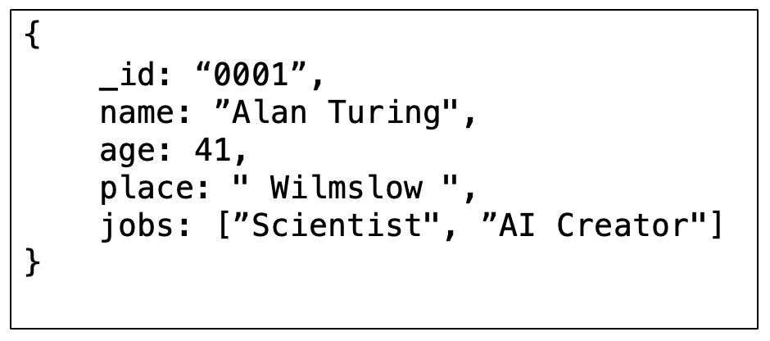
NOSQL DATABASE
NoSQL databases are designed to handle large-scale, unstructured, or semi-structured data.
Highly scalable and often used in distributed data systems.
Storage: Documents, key-value, columns, graphs.
Uses: Real-time web applications, big data analytics, social networks, and content management systems.

Slide 11
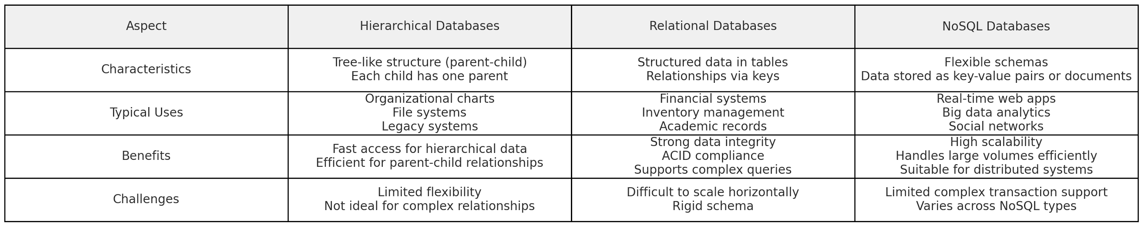
COMPARISON AMONG DATABASES

Slide 12


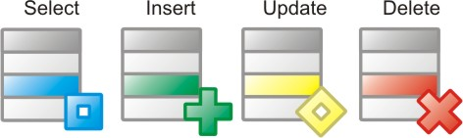

Database Management System
Software that provides an interface for users and applications to interact with a database, managing data storage, retrieval, and security.
Examples: MySQL, PostgreSQL, Oracle DB, Microsoft SQL Server.
DEFINITION
UPDATING
MANAGEMENT

Slide 13

Q&A

